Slide 1
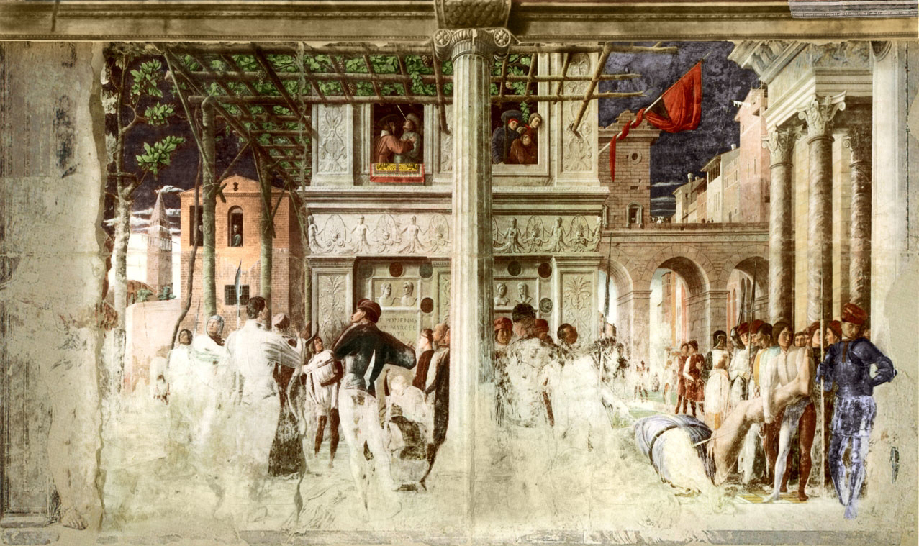
Perspective projection
A. Mantegna, Martyrdom of St. Christopher, c. 1450

Slide 2
Overview
Motivation: recovery of 3D structure
Pinhole projection model
Properties of projection
Perspective projection matrix
Orthographic projection

Slide 3
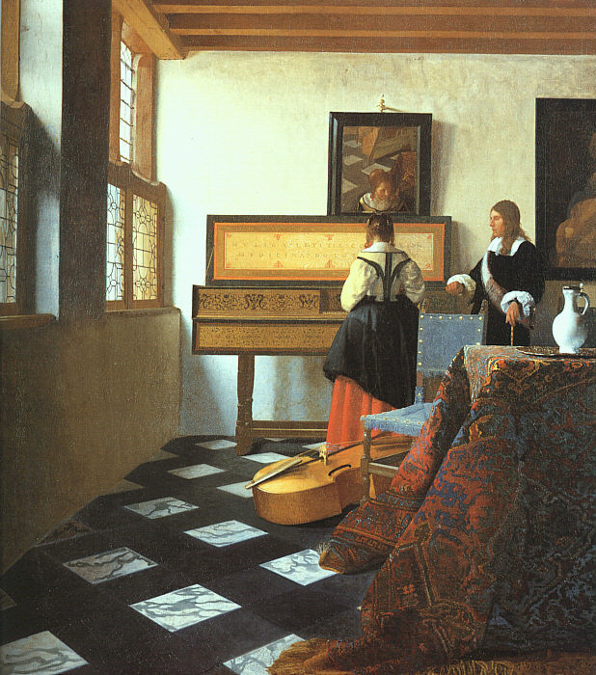
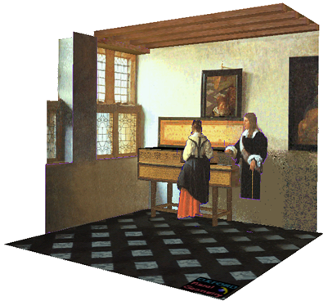
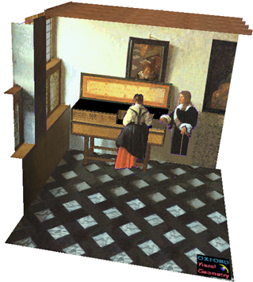
Given an image, can we recover 3D structure?
J. Vermeer, Music Lesson, 1662
A. Criminisi, M. Kemp, and A. Zisserman, Bringing Pictorial Space to Life: computer techniques for the analysis of paintings, Proc. Computers and the History of Art, 2002

Slide 4
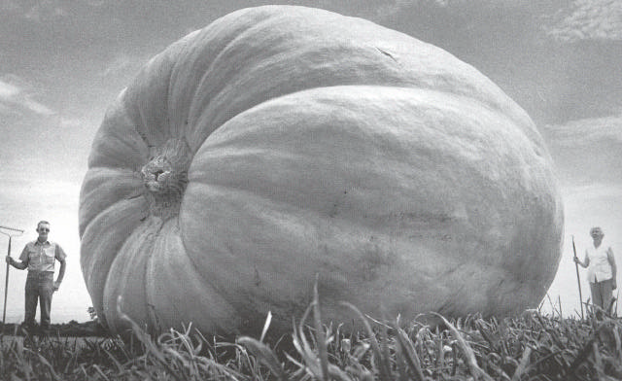
Things aren’t always as they appear…

Slide 5
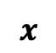
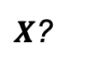
Single-view ambiguity
$X$?
$X$?
$X$?
$$x$$

Slide 6
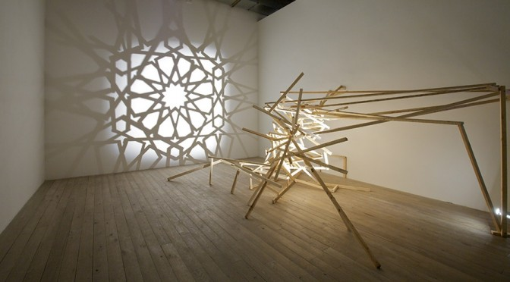
Single-view ambiguity
Rashad Alakbarov shadow sculptures

Slide 7
Anamorphic perspective
Image source

Slide 8
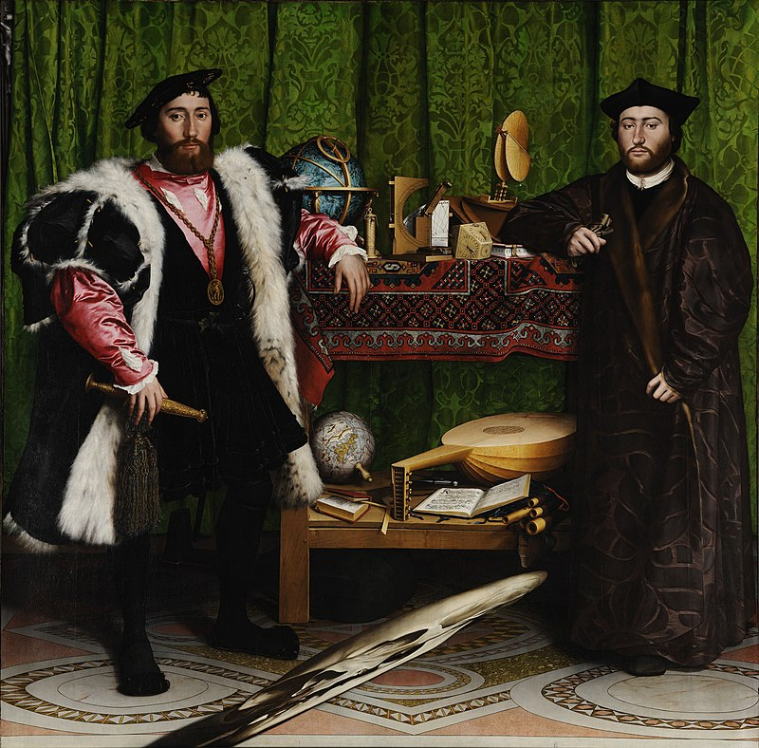

Anamorphic perspective
H. Holbein The Younger, The Ambassadors, 1533
https://en.wikipedia.org/wiki/Anamorphosis

Slide 9
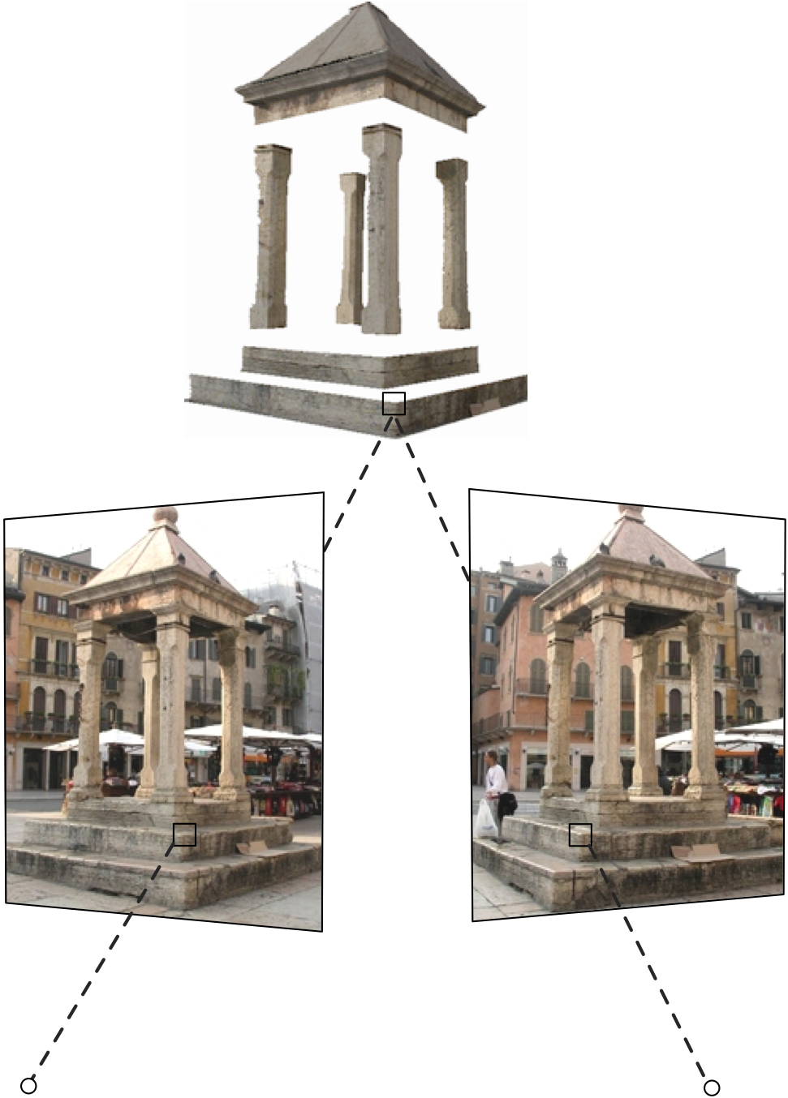

Our goal: Recovery of 3D structure
When certain assumptions hold, we can recover structure from a single view
In general, we need multi-view geometry
Image source
But first, we need to understand the geometry of a single camera…

Slide 10
Overview
Motivation: recovery of 3D structure
Pinhole projection model

Slide 11


Review: Perspective projection equations
$$P$$
$$P′$$

Slide 12

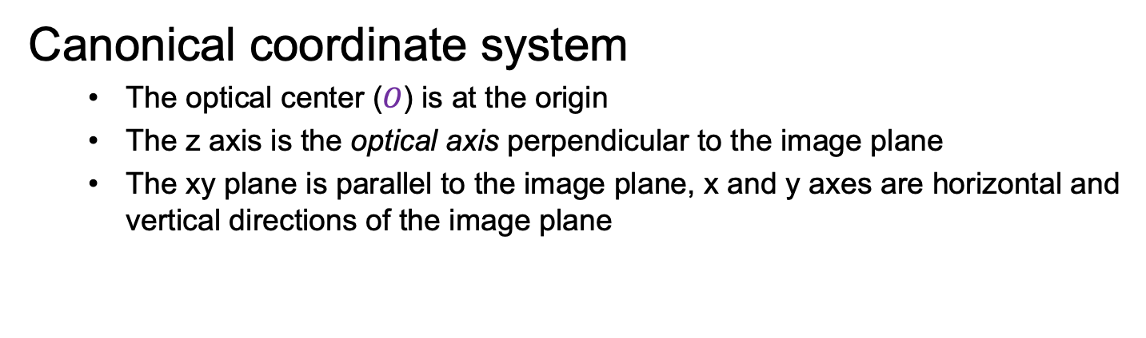



Review: Perspective projection equations
$$P$$
$$y$$
$$z$$
$$O$$
$$x$$
$$P′$$
Canonical coordinate system
The optical center ($O$) is at the origin
The z axis is the optical axis perpendicular to the image plane
The xy plane is parallel to the image plane, x and y axes are horizontal and vertical directions of the image plane

Slide 13



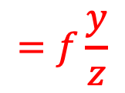
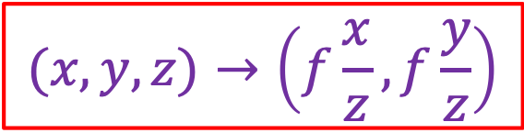

Review: Perspective projection equations
$$P$$
$$y$$
$$f$$
$$z$$
$$=f\frac{y}{z}$$
$$O$$
$$y^{′}$$
$$P′$$
$$(x,y,z)→\left(f\frac{x}{z},f\frac{y}{z}\right)$$

Slide 14
Review: Perspective projection equations
Note: instead of dealing with an image that is upside down, most of the time we will pretend that the image plane is in front of the camera center

Slide 15
Overview
Motivation: recovery of 3D structure
Pinhole projection model
Properties of projection
What happens to:
Lines
Planes
General 3D shapes

Slide 16
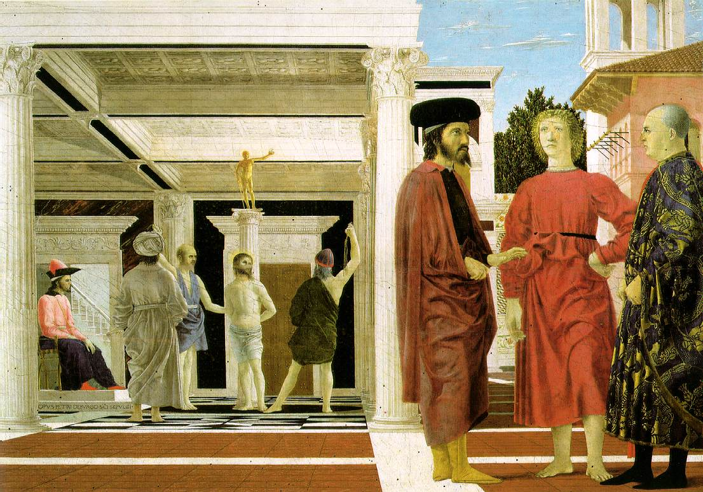
Projection of lines
Piero della Francesca, Flagellation of Christ, 1455-1460

Slide 17
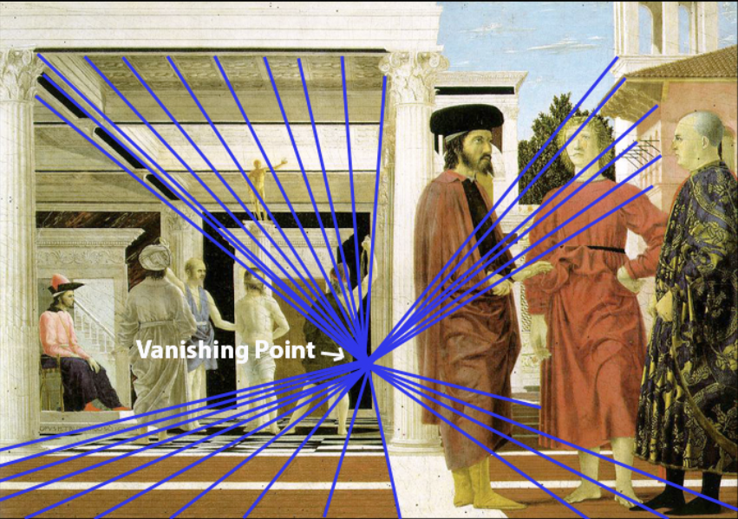
Projection of lines
Parallel lines meet at a vanishing point
Image source
Piero della Francesca, Flagellation of Christ, 1455-1460

Slide 18
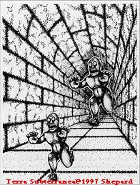
Converging lines are a powerful perspective cue
Slide by Steve Seitz

Slide 19

Constructing the vanishing point of a line
image plane
vanishing point$v$
line in the scene
camera
center
What about another line going in the same direction?
Adopted from S. Seitz

Slide 20
Projection of lines
Do all parallel lines converge to a vanishing point?
Piero della Francesca, Flagellation of Christ, 1455-1460

Slide 21
Projection of lines
Do all parallel lines converge to a vanishing point?
Not parallel lines that are also parallel to the image plane!
Piero della Francesca, Flagellation of Christ, 1455-1460

Slide 22
Projection of planes
What happens to planar patterns?
Piero della Francesca, Flagellation of Christ, 1455-1460

Slide 23
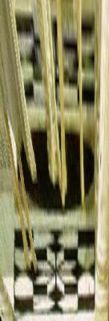
Projection of planes
Patterns on non-fronto-parallel planes are distorted by a 2D homography
Piero della Francesca, Flagellation of Christ, 1455-1460

Slide 24
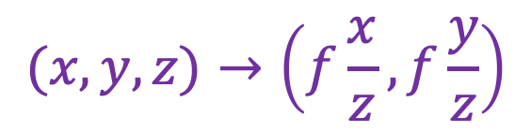
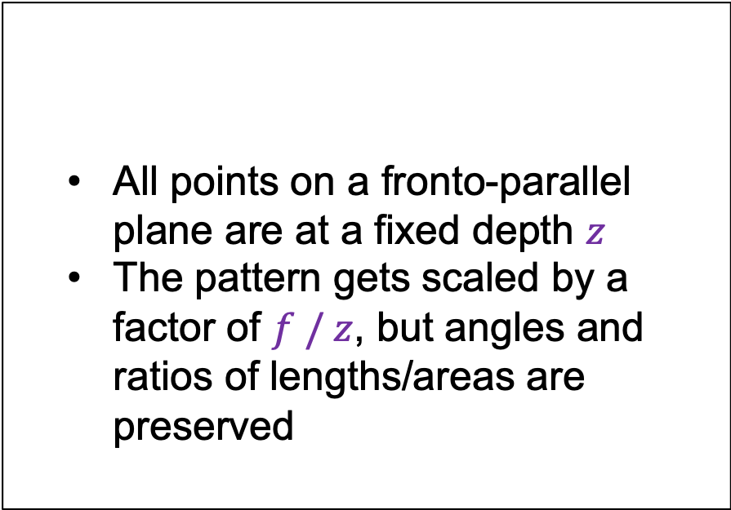
Projection of planes
What about patterns on fronto-parallel planes?
All points on a fronto-parallel plane are at a fixed depth $z$
The pattern gets scaled by a factor of $f / z$, but angles and ratios of lengths/areas are preserved
$$(x,y,z)→\left(f\frac{x}{z},f\frac{y}{z}\right)$$
Piero della Francesca, Flagellation of Christ, 1455-1460

Slide 25
Projection of planes
Non-fronto-parallel planes have vanishing lines
Vanishing line of the ground plane
Piero della Francesca, Flagellation of Christ, 1455-1460

Slide 26
Vanishing lines of planes
Each family of parallel planes is associated with a vanishing line in the image
How can we construct the vanishing line of a plane?

Slide 27
Vanishing lines of planes
Each family of parallel planes is associated with a vanishing line in the image
How can we construct the vanishing line of a plane?
camera
center
plane in the scene
Figure source: S. Seitz

Slide 28

Vanishing lines of planes
Horizon: vanishing line of the ground plane
What can the horizon tell us about the relative height of scene points and the camera?
camera
center
ground plane
Image source: S. Seitz
Notes:
Is this parachutist higher or lower than the person taking this picture?
Lower—he is below the horizon

Slide 29
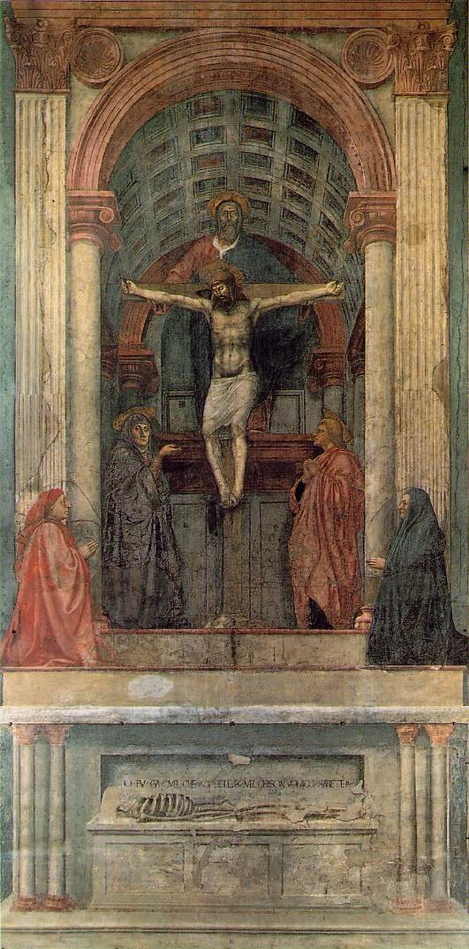
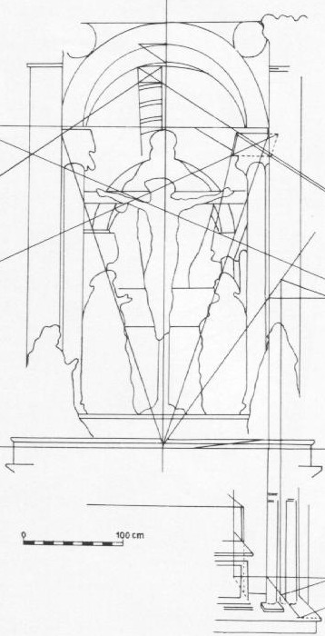
Symbolic use of vanishing points and lines
Masaccio, Trinity, Santa Maria Novella, Florence, 1425-28
One of the first consistent uses of perspective in Western art

Slide 30
Projection of 3D shapes
What is are the relationships between the geometric properties of general 3D surfaces and their 2D projections?
Barbara Hepworth sculpture

Slide 31
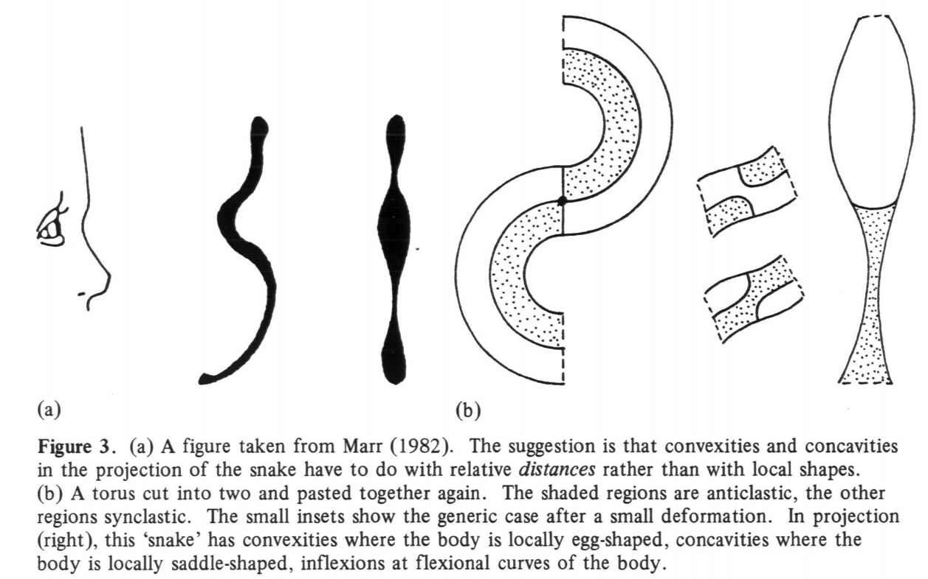
Projection of 3D shapes
J. Koenderink. What does the occluding contour tell us about solid shape? Perception 13 (321-330), 1984

Slide 32
Projection of 3D shapes
J. Koenderink. What does the occluding contour tell us about solid shape? Perception 13 (321-330), 1984

Slide 33
Projection of 3D shapes
J. Koenderink. What does the occluding contour tell us about solid shape? Perception 13 (321-330), 1984

Slide 34
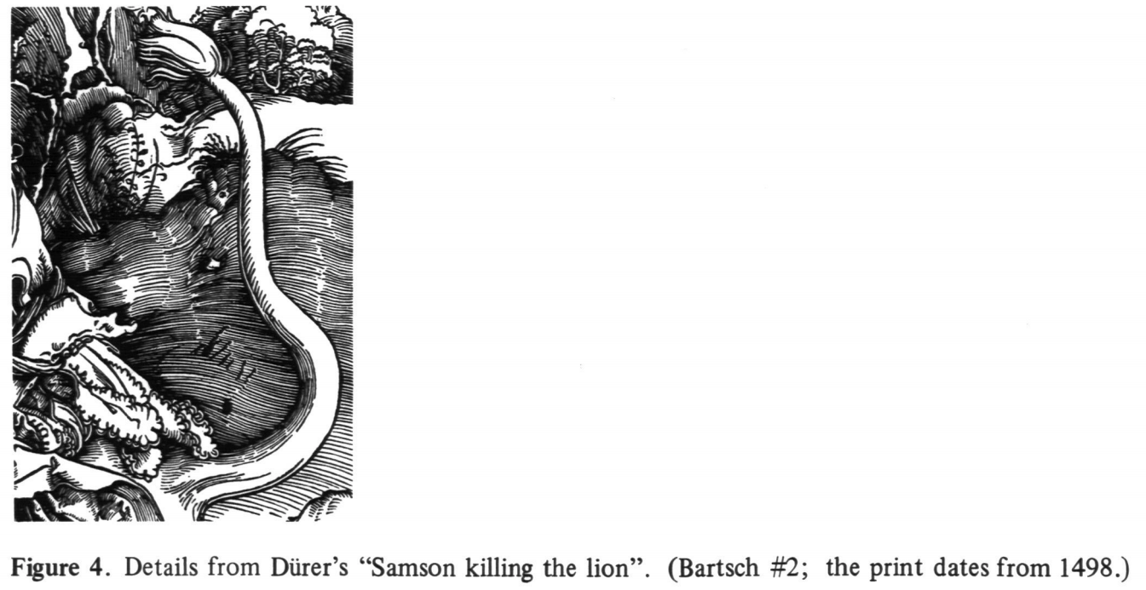
Projection of 3D shapes
J. Koenderink. What does the occluding contour tell us about solid shape? Perception 13 (321-330), 1984

Slide 35
Projection of 3D shapes
What is the shape of the projection of a sphere?
Image source: F. Durand

Slide 36
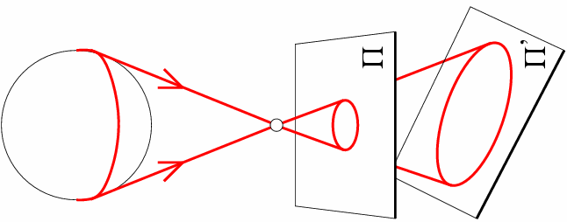
Projection of 3D shapes
What is the shape of the projection of a sphere?

Slide 37
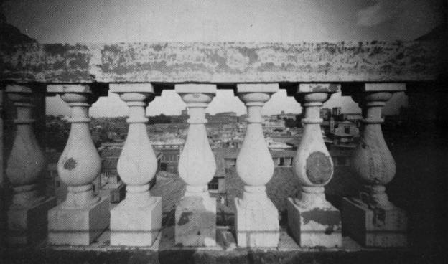
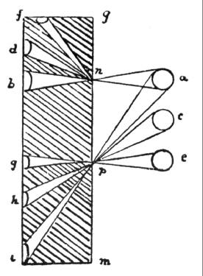
Projection of 3D shapes
Are the widths of the projected columns equal?
The exterior columns are wider
This is not an optical illusion, and is not due to lens flaws
Phenomenon pointed out by Leonardo Da Vinci
Source: F. Durand

Slide 38

Perspective distortion: People

Slide 39
Overview
Motivation: recovery of 3D structure
Pinhole projection model
Properties of projection
Perspective projection matrix
Orthographic projection

Slide 40
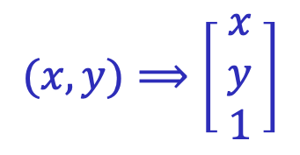
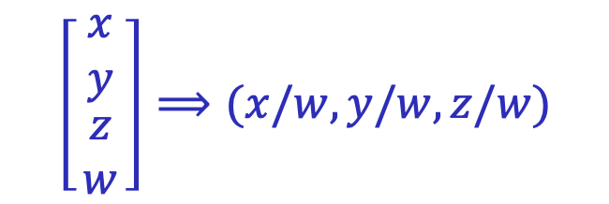
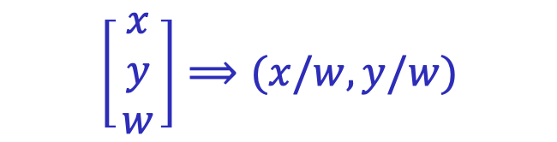
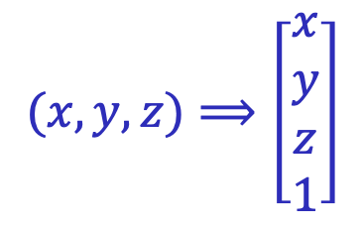
Recall: Homogeneous coordinates
To form homogeneous coordinates from normal Euclidean coordinates, append 1 as the last entry:
$$(x,y,z)⟹\left[\begin{aligned}x \\ y \\ z \\ 1\end{aligned}\right]$$
$$(x,y)⟹\left[\begin{matrix}x \\ y \\ 1\end{matrix}\right]$$
homogeneous image
coordinates
homogeneous scene
coordinates
To convert from homogeneous coordinates, divide by the last entry:
$$\left[\begin{matrix}x \\ y \\ \begin{aligned}z \\ w\end{aligned}\end{matrix}\right]⟹(x/w,y/w,z/w)$$
$$\left[\begin{matrix}x \\ y \\ w\end{matrix}\right]⟹(x/w,y/w)$$
In homogeneous coordinates, all scalar multiples represent the same point!

Slide 41
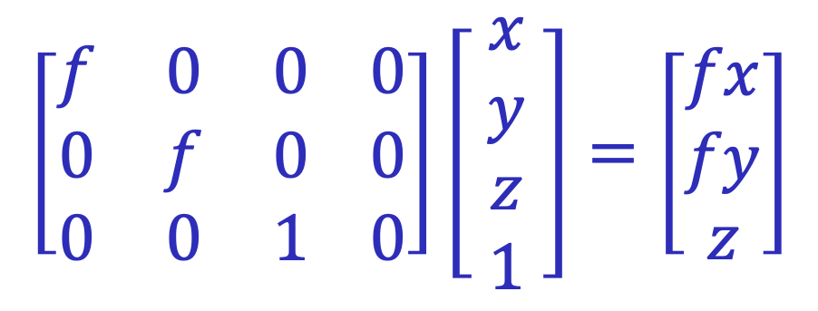
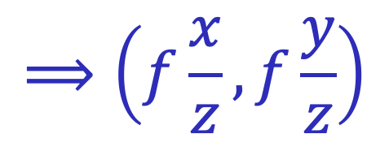
Perspective projection matrix
Projection is a matrix multiplication using homogeneous coordinates:
$$\left[\begin{matrix}f & 0 & 0 0 \\ 0 & f & 0 0 \\ 0 & 0 & 1 0\end{matrix}\right]\left[ \begin{aligned}x \\ y \\ z \\ 1\end{aligned} \right]=\left[\begin{matrix}fx \\ fy \\ z\end{matrix}\right]$$
$$⟹\left(f\frac{x}{z},f\frac{y}{z}\right)$$
divide by the third coordinate

Slide 42
Orthographic projection
Special case of perspective projection
Distance from center of projection to image plane is infinite
Also called “parallel projection”
Image
World
Slide by Steve Seitz
Notes:
Is this a linear function?

Slide 43
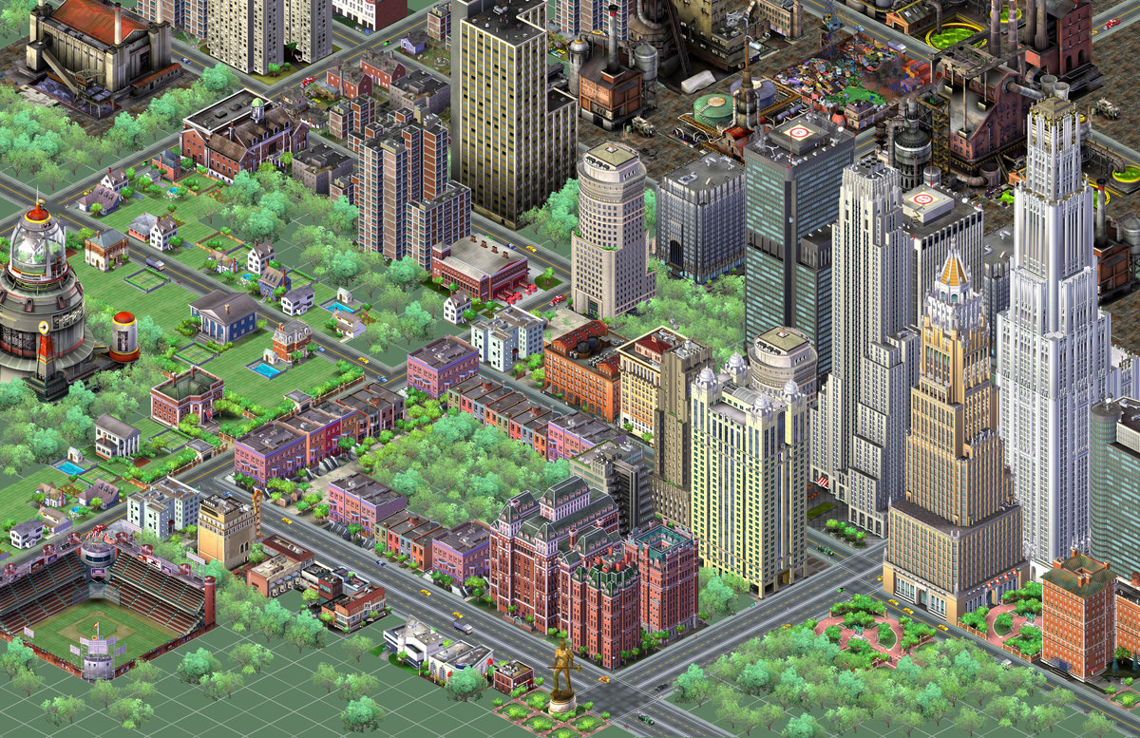
Orthographic projection
Special case of perspective projection
Distance from center of projection to image plane is infinite
Also called “parallel projection”
Notes:
Is this a linear function?

Slide 44
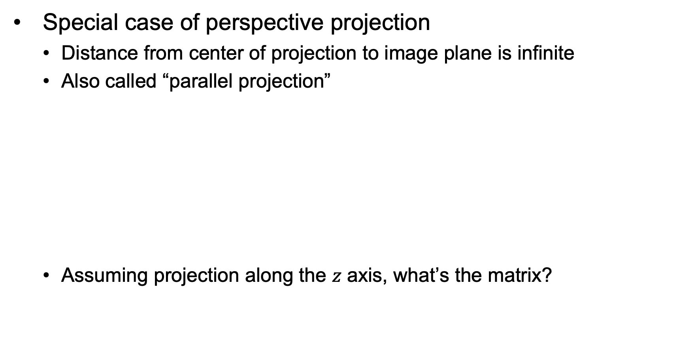
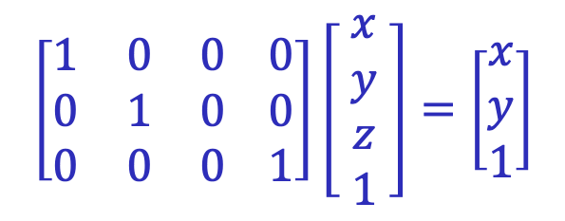
Orthographic projection
Special case of perspective projection
Distance from center of projection to image plane is infinite
Also called “parallel projection”
Assuming projection along the $z$ axis, what’s the matrix?
Image
World
$$\left[\begin{matrix}1 & 0 & 0 0 \\ 0 & 1 & 0 0 \\ 0 & 0 & 0 1\end{matrix}\right]\left[ \begin{aligned}x \\ y \\ z \\ 1\end{aligned} \right]=\left[\begin{matrix}x \\ y \\ 1\end{matrix}\right]$$
Slide by Steve Seitz
Notes:
Is this a linear function?

Slide 45
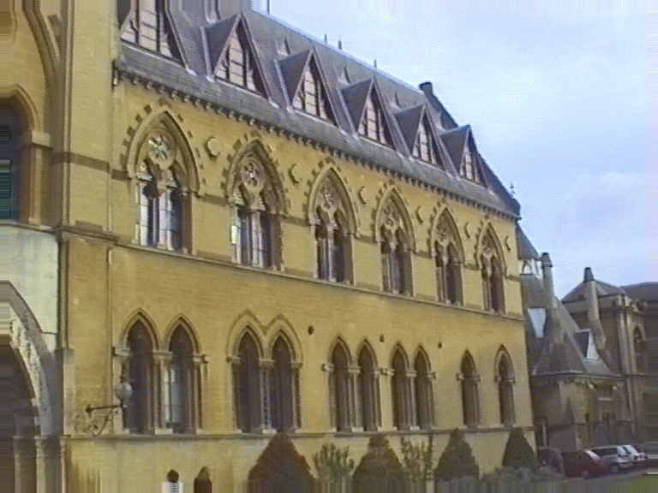
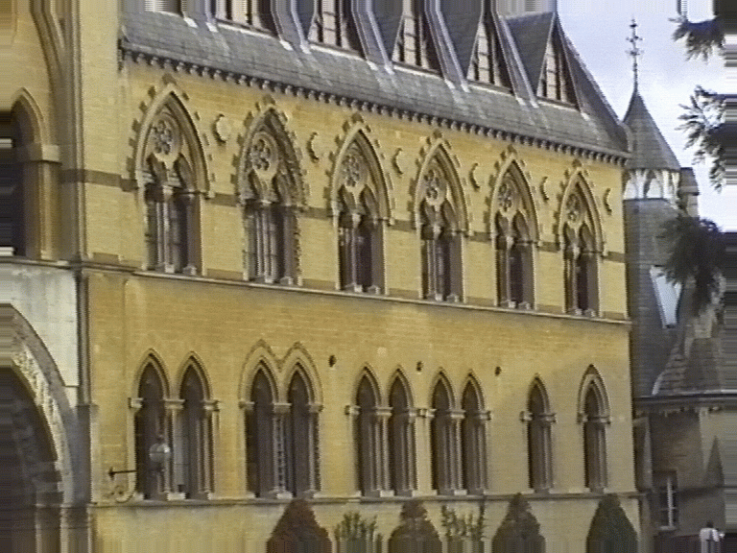
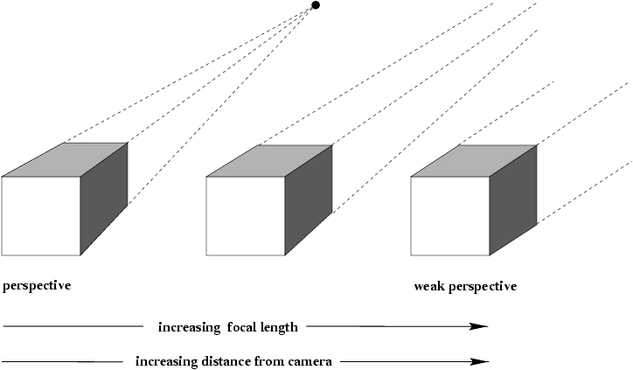
Approximating an orthographic camera
center at infinity
Source: Hartley & Zisserman

